Slide 1
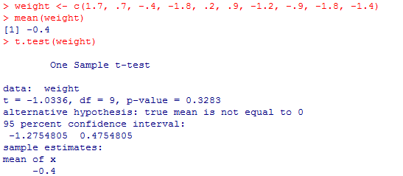
Interval Estimation I slides: Page 13-16
R

Slide 2
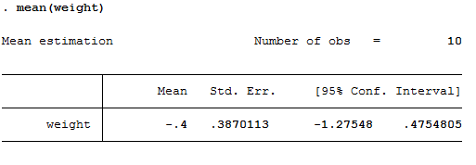
Interval Estimation I slides: Page 13-16 STATA
edit
var1
1.7
.7
-.4
-1.8
.2
.9
-1.2
-.9
-1.8
-1.4
rename var1 weight

